Slide 1
FDA Drug Approval Trends: Detailed Analysis and Insights
Data Analysis, Trends, Conclusions, and Recommendations

Slide 2
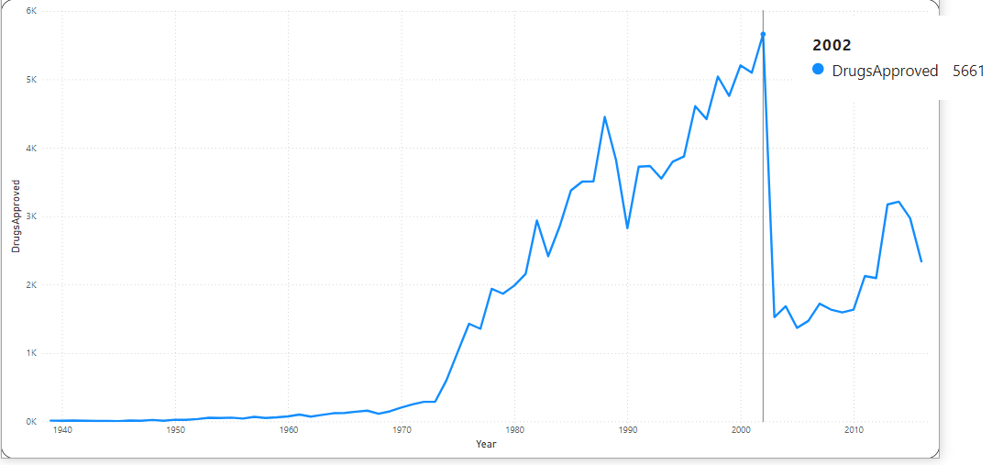
Yearly Approval Trends of Drugs
• Drug approvals have fluctuated over the years, with significant peaks in certain years.
• An overall trend of increasing approvals with some periodic declines.
Out of Total Approvals: 20k
Conclusion:
• Regulatory policies or breakthrough therapies likely influenced approval spikes.
Suggestions:
• Further analysis of external factors (e.g., policy changes, major approvals) could help explain these trends.

Slide 3
Approval Trends Based on Sponsors
• Approval trends show differences across various sponsors.
• Some sponsors consistently receive more approvals, while others have seen fluctuations.
Conclusion:
• Larger sponsors tend to maintain a steady rate of approvals, while smaller ones experience variability.

Slide 4
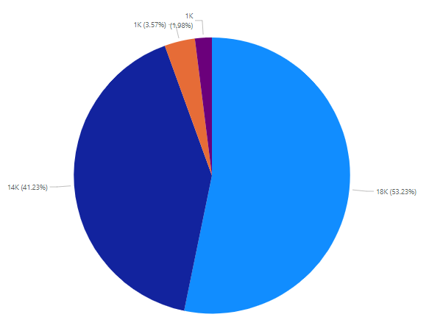
Segmentation of Products by Marketing Status
• Most products fall under the ‘Marketed’ status, followed by ‘Pending’ and ‘Pre-marketing’.
• ‘Withdrawn’ products represent a smaller portion of the total.
Conclusion:
• The majority of approved products reach the market, while some are withdrawn or remain in pending status.
Suggestions:
• Examine the reasons for 'Withdrawn’ as well as ‘Pre-market’ products—could there be safety or regulatory issues? This can guide future product approvals.

Slide 5
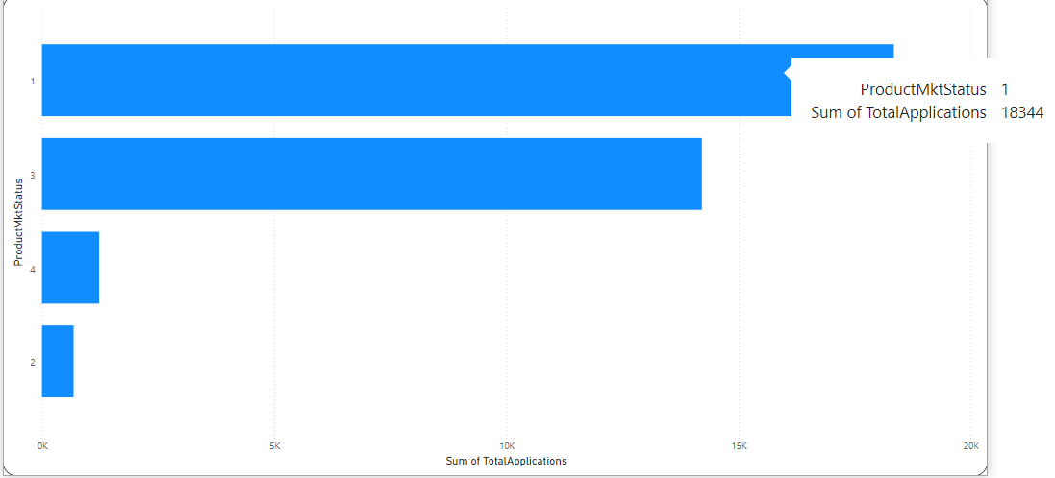
Total Applications by MarketingStatus
• The number of applications varies significantly by Marketing Status across different years.
• 'Marketed' products consistently have the highest number of applications.
Conclusion:
• 'Marketed' products receive the most applications, while 'Withdrawn' or 'Pending' have lower numbers.
Suggestions:
• Further breakdown of applications by year and Marketing Status can help identify specific trends in application behavior.

Slide 6
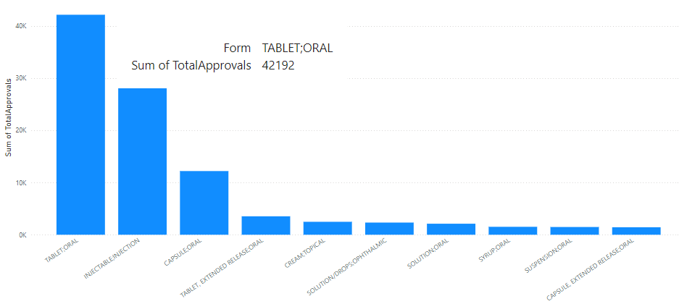
Drug Approvals by Dosage Form
• Approvals are concentrated in a few key dosage forms, with certain forms being more successful than others.
• Oral dosage forms dominate the approvals, followed by injectable forms.
Conclusion:
• Oral and injectable forms are the most successful, while others have fewer approvals.
Suggestions:
• Explore why certain dosage forms dominate and whether there's a correlation with market demand or patient preference.

Slide 7
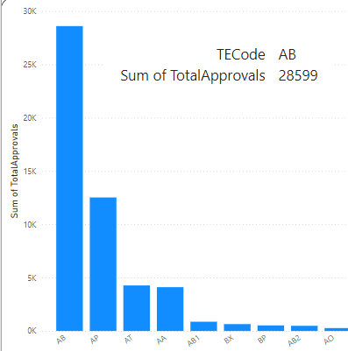
Drug Approvals by Therapeutic Classes
Some therapeutic classes have a much higher number of approvals compared to others.
• Classes like 'Oncology' and 'Cardiovascular' have the most approvals.
Conclusion:
• The therapeutic classes with the most approvals align with critical areas of medical need.
Suggestions:
• Focus on the leading therapeutic classes and assess what factors are driving approvals in these areas (e.g., funding, R&D).

Slide 8
Conclusion and Recommendations
Conclusion:
• Drug approval trends show varying patterns based on years, sponsors, and therapeutic areas.
• Marketed products and oral dosage forms dominate the approval space.
• Certain therapeutic classes like 'Oncology' see more approvals, reflecting medical demand.
Recommendations:
• Investigate external factors affecting approval rates (e.g., policies, market needs).
• Focus on improving the approval process for pending products to reduce delays.
• Evaluate the success factors in dominant dosage forms and therapeutic classes for future R&D focus.

